Slide 1
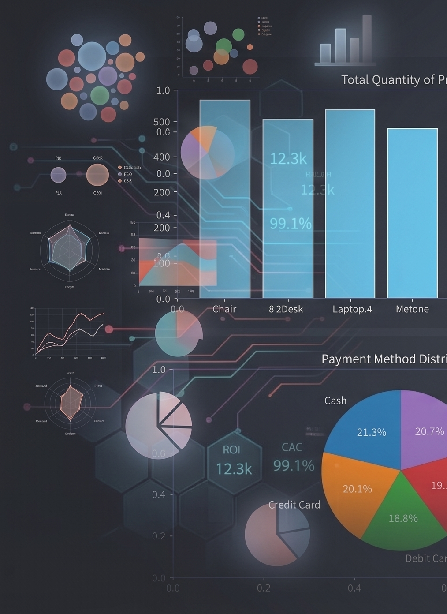
Data Analysis System
A desktop application that transforms manual spreadsheet workflows into a streamlined, end-to-end data pipeline — upload, edit, analyze, and export, all in one place.

Slide 2
PROJECT OVERVIEW
What This Application Does
Built with Python, PyQt6, Pandas, and MySQL, this desktop tool replaces fragmented Excel workflows with a single integrated environment for data management and analysis.
Login & Register
Upload Excel
Secure authentication layer
Import spreadsheets directly
Edit & Search
Database Storage
Inline editing and find
Persist data in MySQL
Graphical Analysis
Export to Excel
Visualize with charts
Save results back out

Slide 3
PROBLEM & SOLUTION
From Manual Chaos to Streamlined Workflow
The Problem
The Solution
Manual Excel processing is slow, error-prone, and doesn't scale. Teams waste hours on repetitive data entry, formatting, and analysis — with no centralized storage or audit trail.
An integrated desktop application that handles the full data lifecycle: upload, edit, store, analyze, and export — all within a single, cohesive interface backed by a real database.

Slide 4

TECH STACK
Technologies Behind the System
Python
PyQt6
Core language powering all application logic, data processing, and backend operations.
Desktop GUI framework for building the native application interface and user interactions.
Pandas
MySQL + SQLAlchemy
Data manipulation and analysis — reading, transforming, and querying Excel datasets.
Relational database with ORM layer for structured, persistent data storage.
Matplotlib
OpenPyXL
Charting library for generating bar charts, pie charts, and business visualizations.
Excel file handling for reading and writing .xlsx workbooks during import and export.

Slide 5
FEATURES
Core Capabilities
Authentication
Excel Import & Editable Table
Search & Save
Secure login and registration with session management to protect user data.
Find records instantly and persist changes back to the MySQL database.
Upload any Excel file and edit data inline within a responsive table view.
Revenue Analysis & Charts
Export to Excel
Download processed and analyzed data back to a formatted Excel workbook.
Visualize key business metrics — revenue, products, payments, and order status.

Slide 6
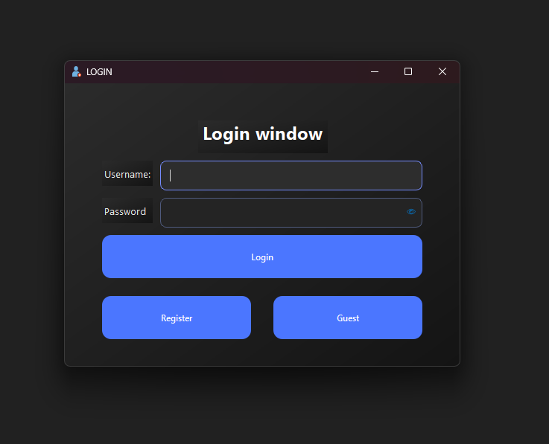
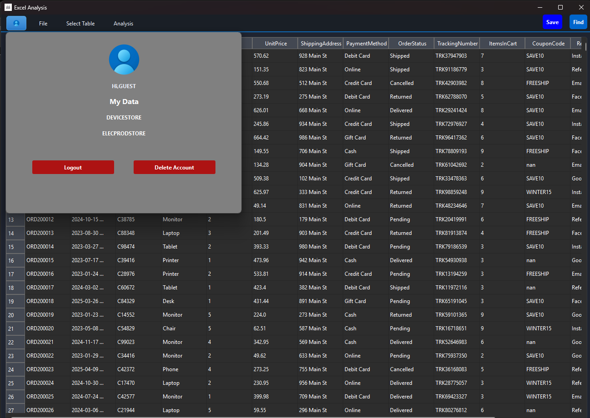
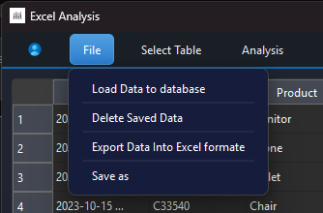
SCREENSHOTS
Application in Action
The interface combines a clean table view for data editing with integrated chart panels for instant visual analysis — all within a single desktop window.

Slide 7
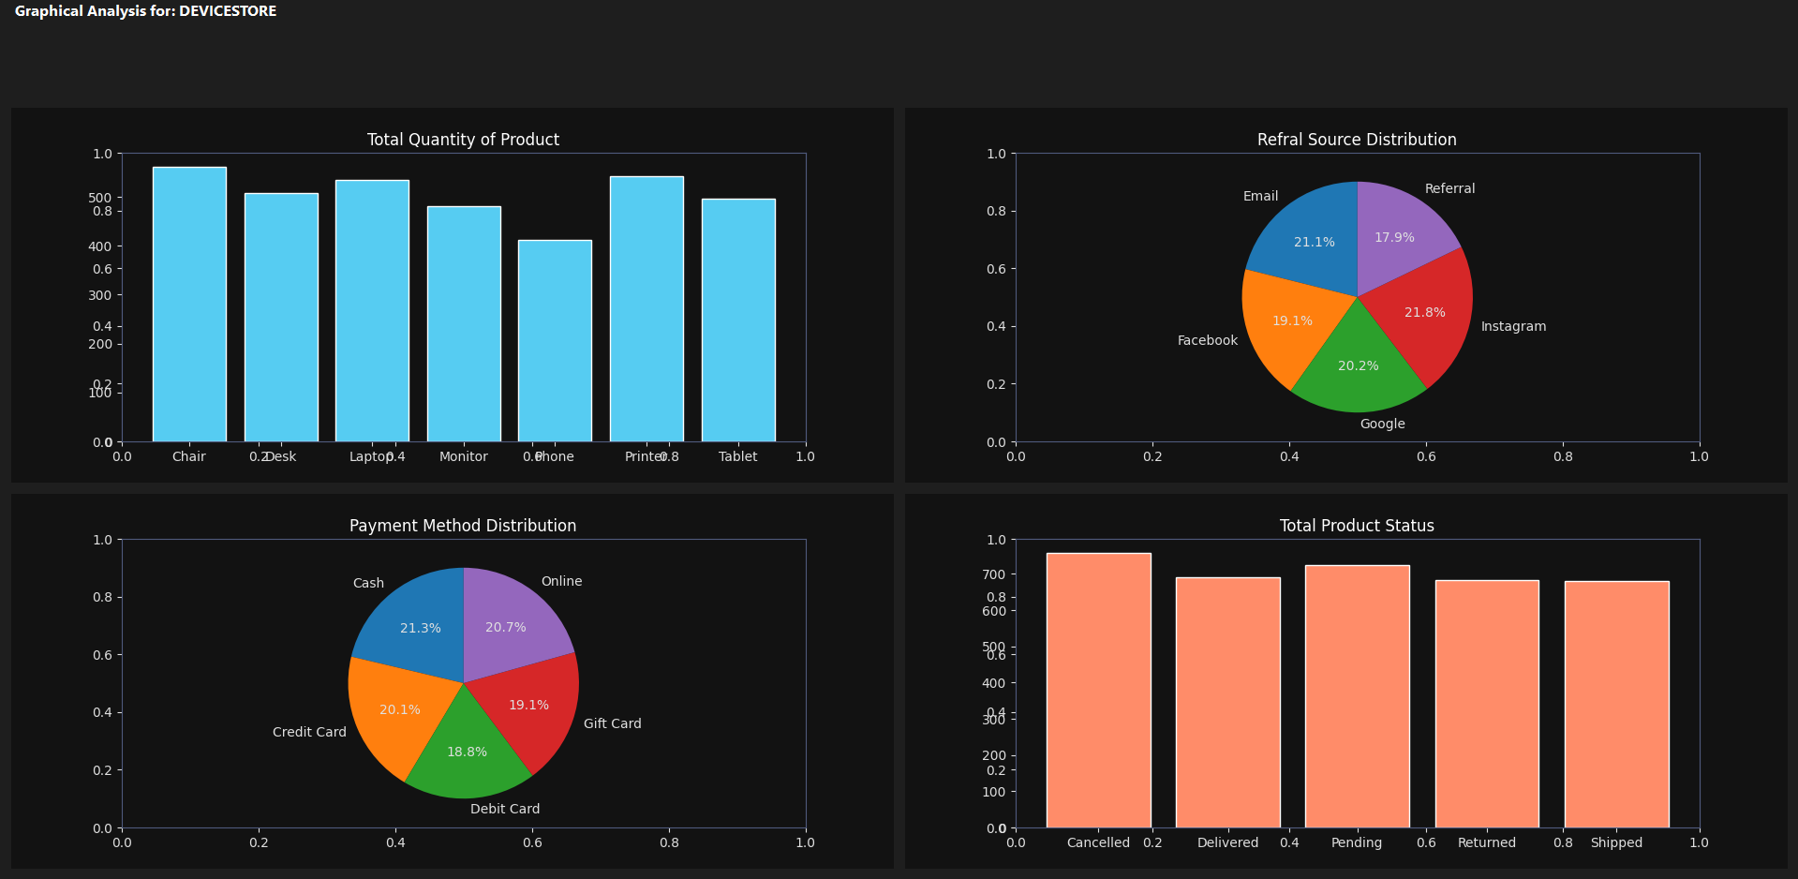
GRAPHICAL ANALYSIS
Business Insights Through Visualization
What Gets Visualized
Matplotlib-powered charts turn raw spreadsheet rows into actionable business intelligence:
Products — revenue and volume by product line
Payments — transaction trends and status breakdowns
Referrals — source attribution and conversion rates
Order Status — pie and bar charts for pipeline visibility

Slide 8
CHALLENGES
Engineering Hurdles Overcome
Large Excel Files
Database Sync
Dynamic Graphs
Optimizing Pandas reads to handle high-volume datasets without freezing the GUI.
Keeping the MySQL store consistent with in-memory table edits and user actions.
Rendering charts that update in real time as filters and data selections change.
GUI Design
Error Handling
Balancing feature density with usability in a PyQt6 desktop interface.
Graceful fallbacks for malformed Excel files, connection failures, and edge cases.

Slide 9
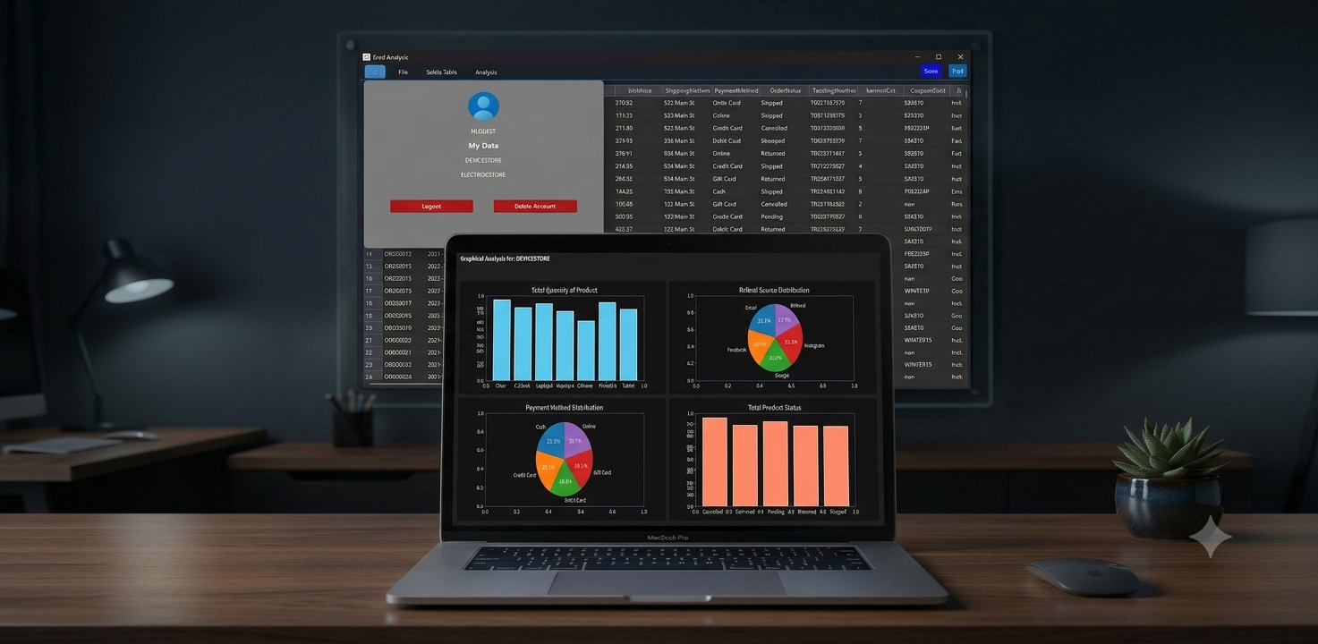
CONCLUSION
A Foundation for Smarter Data Work
This system demonstrates that a well-architected desktop application can replace fragmented, manual Excel workflows — delivering speed, reliability, and insight in a single package.
Built
Solved
Python + PyQt6 + Pandas + MySQL
Manual, error-prone Excel processing
Delivered
Upload, edit, analyze, export — end to end

